Slide 1
Week 1 Tutorial
Introduction to Business Analysis and Valuation
Zirui Song
^{Feb 2025}

Slide 2
Tutorial information
Phone number: 0481906050
Email: zirui.song@research.uwa.edu.au
Indicative assessment
10% of the assessment is allocated for your participation in the workshops;
Team project and presentation account for 30% of the assessment;
The final exam makes up 50% and the remain 10% is allocated to quizzes.

Slide 3
Questions
E 1.1.
E 1.3.
E 1.5.
E 2.12.

Slide 4
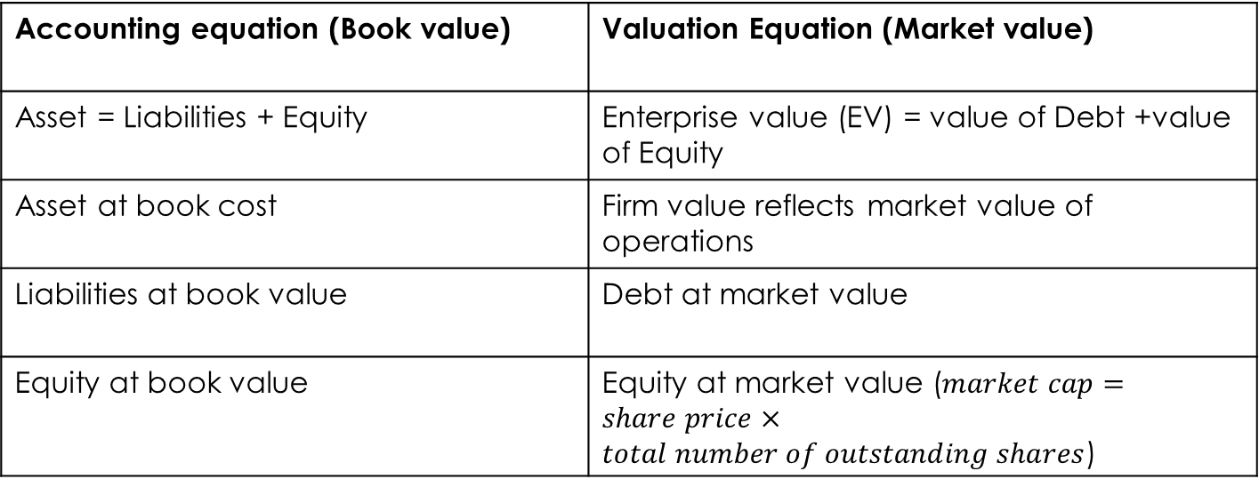
Knowledge review 1
Accounting equation (Book value) | Valuation Equation (Market value)
Asset = Liabilities + Equity | Enterprise value (EV) = value of Debt +value of Equity
Asset at book cost | Firm value reflects market value of operations
Liabilities at book value | Debt at market value
Equity at book value | Equity at market value ($market cap=share price×total number of outstanding shares$)

Slide 5
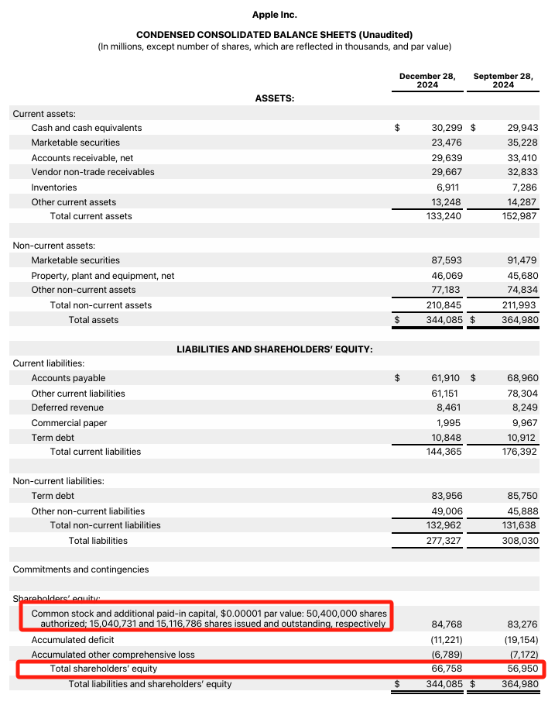
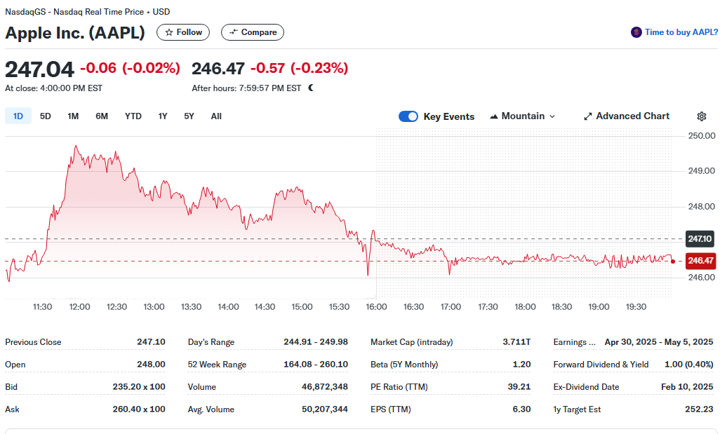
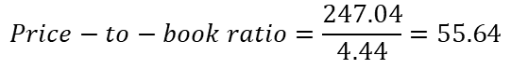
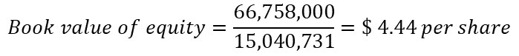
$$Book value of equity=\frac{66,758,000}{15,040,731}=\$ 4.44 per share$$
$$Price−to−book ratio=\frac{247.04}{4.44}=55.64$$
Source: https://s2.q4cdn.com/470004039/files/doc_earnings/2025/q1/filing/10Q-Q1-2025-as-filed.pdf

Slide 6
Question 1
Answer
This exercise tests the understanding of the basic value relation:
Enterprise Value = Value of Debt + Value of Equity
Enterprise Value = $600 + $1,200 million
= $1,800 million
(Enterprise value is also referred to as the value of the firm, and sometimes as the value of the operations).

Slide 7
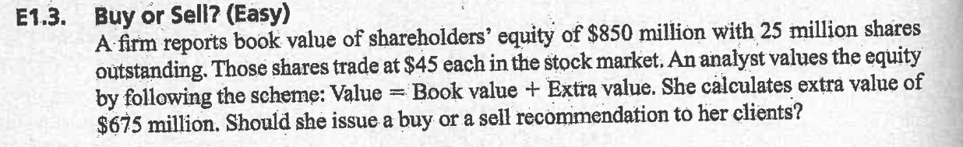
Question 2
Answer
Value = $850 + $675 = $1,525 million
Value per share = $1,525/25 = $61
Market price = $45
Therefore, BUY!

Slide 8
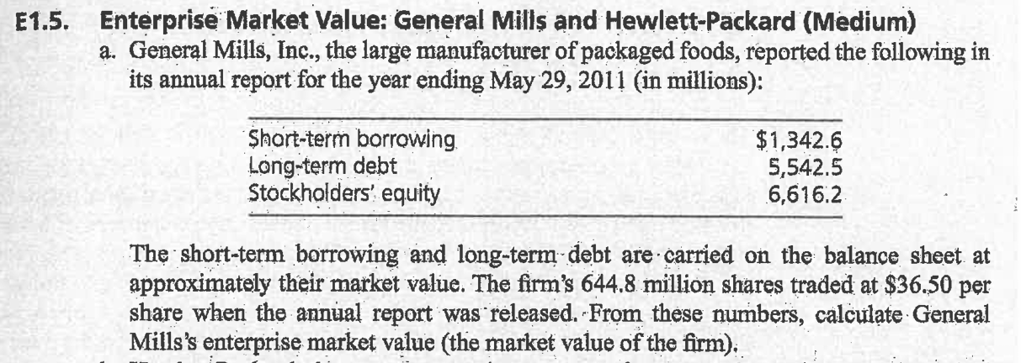
Question 3

Slide 9
Question 3 (cont.)
Answer
(a) General Mills
Market value of the equity = $36.50 × 644.8 million shares = | $23,535.2 million
Book value of total (short-term and long-term) debt = $1,342.6+ $5,542.5 = | 6,885.1 million
Enterprise value | $30,420.3 million

Slide 10
Knowledge review 2
Value formula
Enterprise Value = Value of Debt + Value of Equity
Enterprise Value = Net debt (Value of Debt-Cash and Cash Equivalents*) + Value of Equity
* government bond, corporate bond, certificates of deposit, CDs, treasury bills, etc.
operating asset V.S. non-operating asset
In non-financial industries, cash is a non-operating asset that can be used to pay down debt, thereby reducing the buyer’s purchase price of the business.
How about financial firms? Like bank, insurance, and hedge fund.

Slide 11
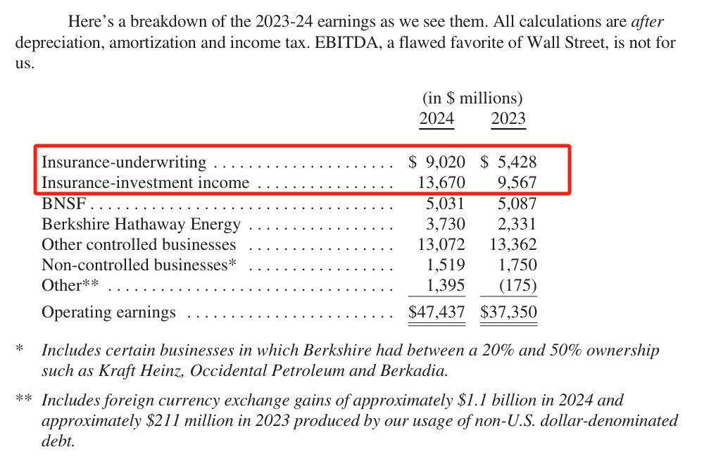
Source: https://www.berkshirehathaway.com/2024ar/2024ar.pdf

Slide 12
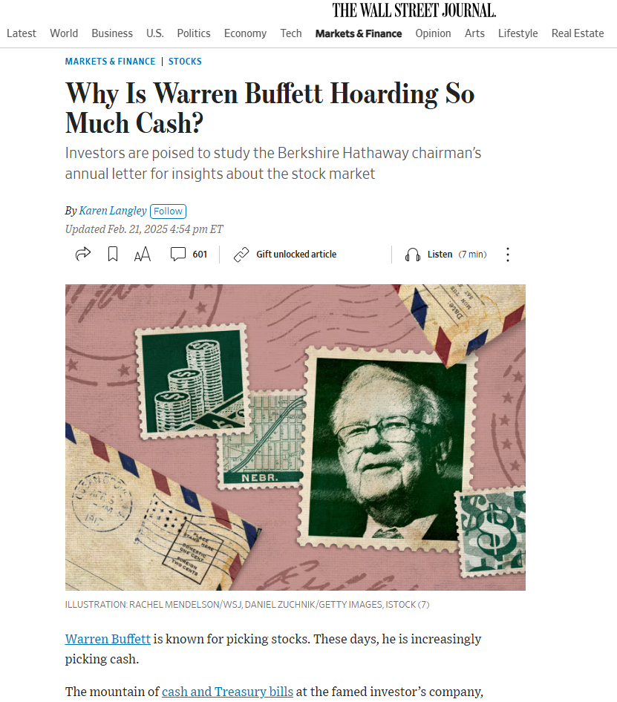
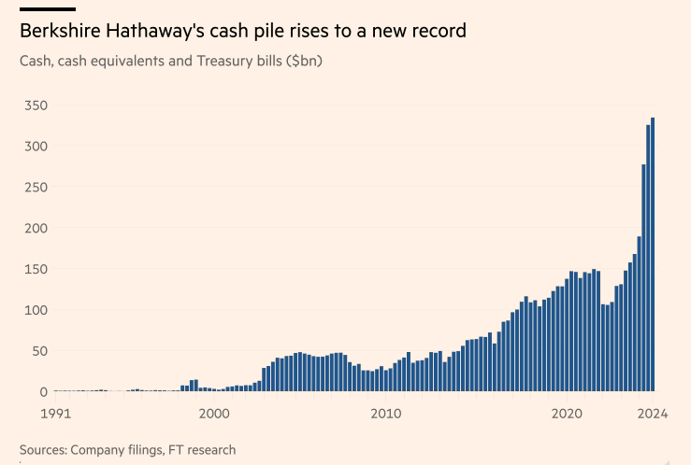

Slide 13
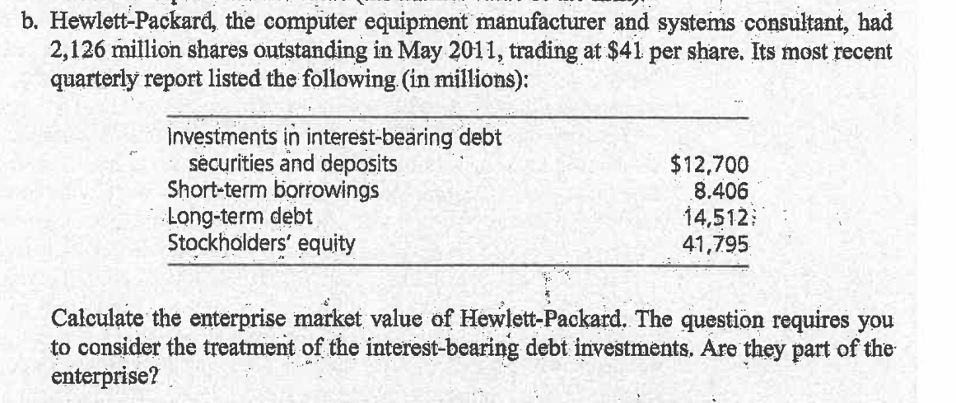
Question 3 (cont.)

Slide 14
Question 3 (cont.)
Answer
Market value of equity = $41 × 2,126 million shares = $ 87,166 million
Book value of net debt claims:
Short-term borrowing | $ 8,406 million
Long-term debt | 14,512
Total debt | $22,918 million
Debt assets | 12,700 | 10,218 (net debt)
Enterprise value |  | 97,384 million

Slide 15
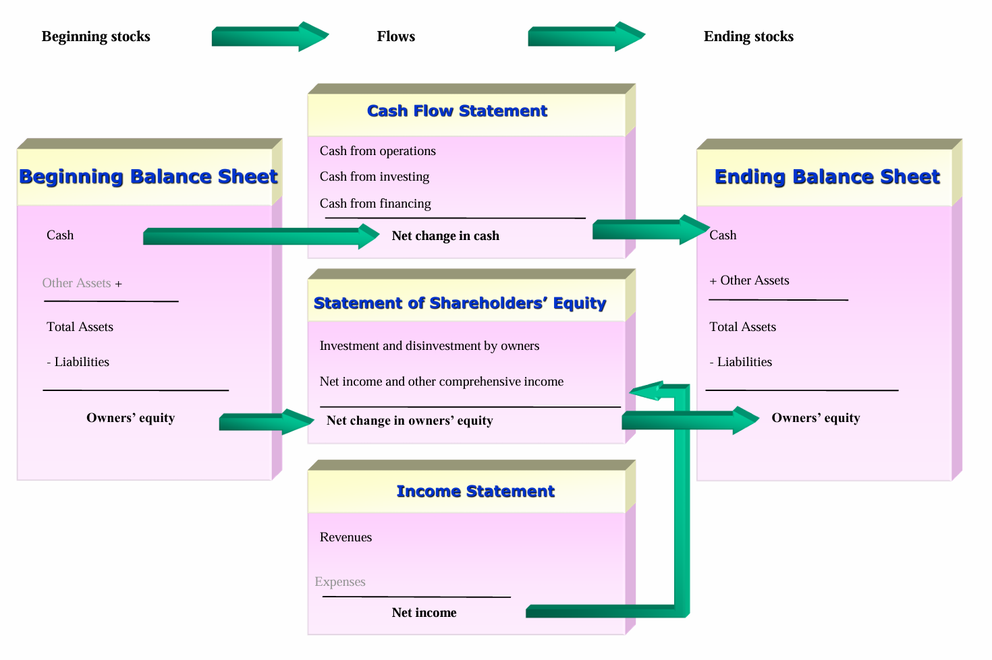
Knowledge review 3
Source: lecture slide, P10

Slide 16
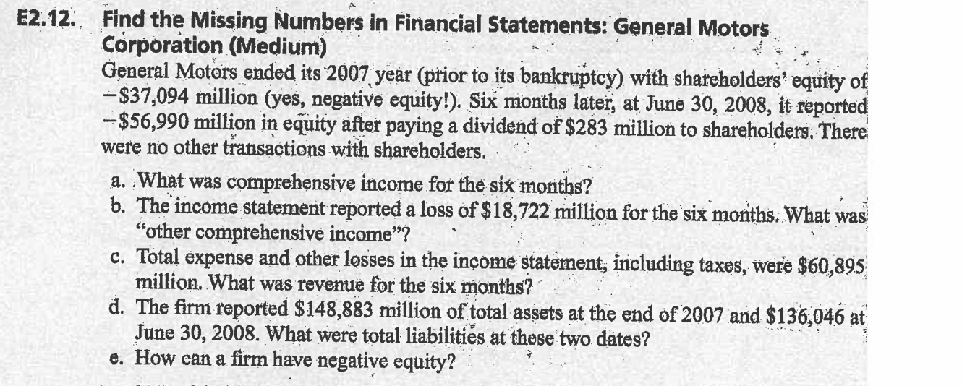
Question 4

Slide 17
Question 4 (cont.)
Total Equity (end) = Total Equity (beginning) + Comprehensive Income – Net
Payout to Shareholders
-56,990 = -37,094 + ? – 283
? = -19,613 (a loss)

Slide 18
Question 4 (cont.)
b. Comprehensive income = Net income + Other comprehensive income
-19,613 = -18,722 + ?
? = - 891

Slide 19
Question 4 (cont.)
c. Net income = Revenue – expenses and losses
-18,722 = ? – 60,895
? = 42,173

Slide 20
Question 4 (cont.)
d. June 30, 2008 December 31, 2007
Assets 136,046 148,883
Liabilities ? = 193,036 ? = 185,977
Equity -56,990 -37,094

Slide 21
Question 4 (cont.)
e. A firm has negative equity when its liabilities are greater than its assets, meaning it owes more than it owns. This usually happens due to sustained losses, which reduced retained earnings.

